Slide 1
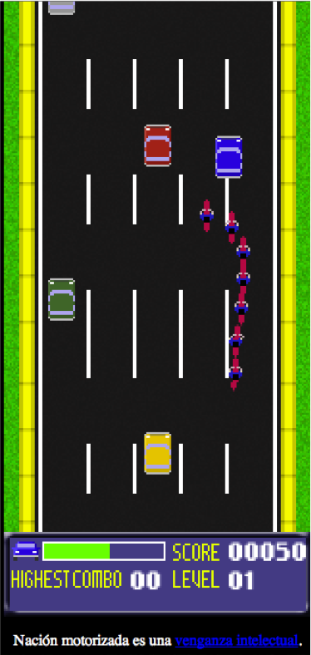
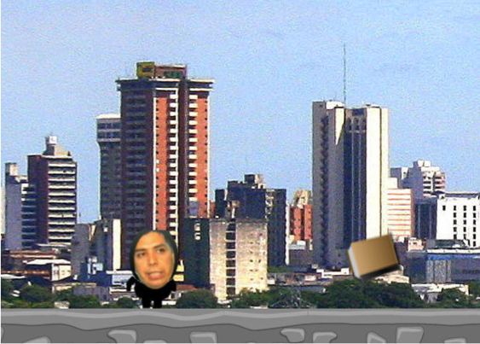
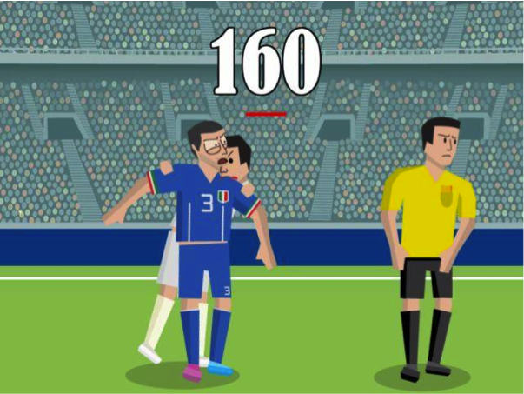
Week 11: Newsgames and Political Parodies

Slide 2


Slide 3
Types of Newsgames
current event newsgames
editorial games
tabloid games
reportage games
infographic newsgames
documentary newsgames
puzzle newsgames
literacy newsgames
community newsgames

Slide 4
Characteristics of Newsgames
“any intersection of journalism and gaming” (13)
“borrow from simple arcade, home console, and casual games” (14)
low system requirements and broad distribution (15)
capitalize on public interest (tabloid newsgames) (16)
timely (including cyclical events) (18-19)
varying levels of bias vs. ambiguity

Slide 5
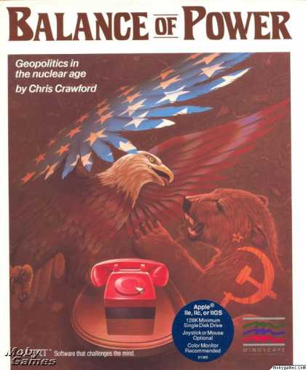
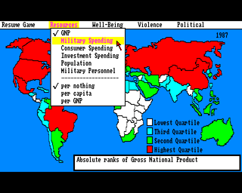

Slide 6
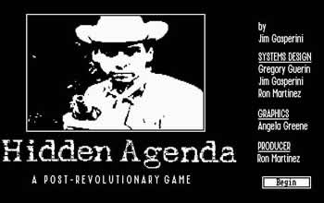
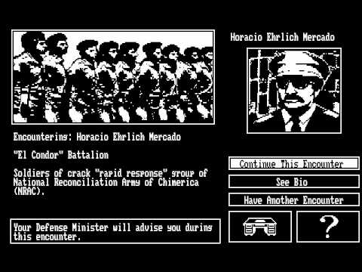

Slide 7
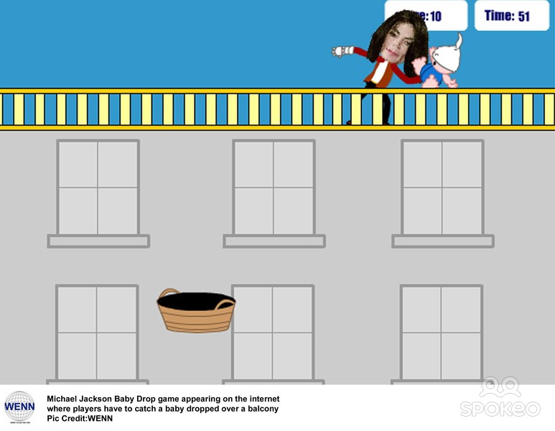

Slide 8
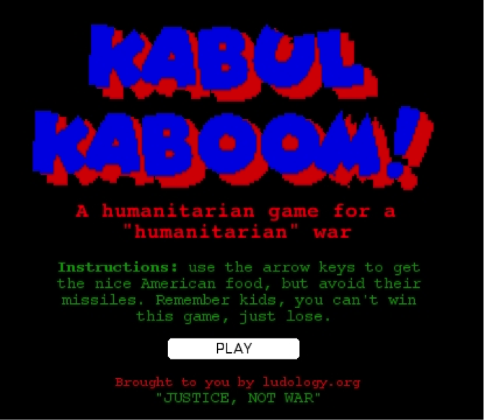
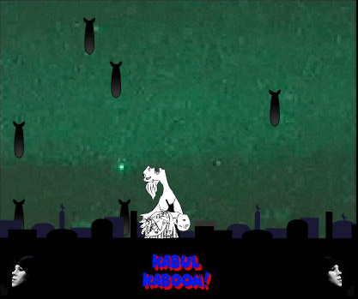

Slide 9
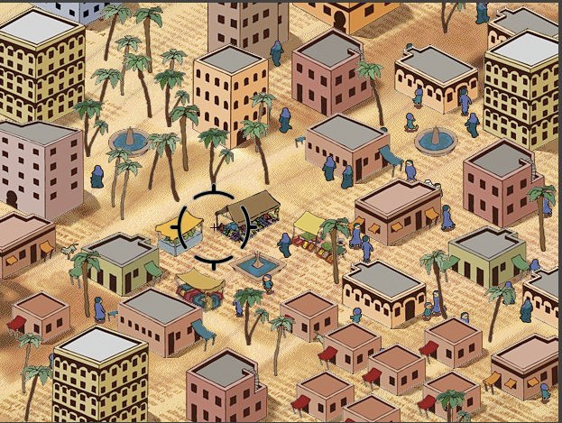

Slide 10

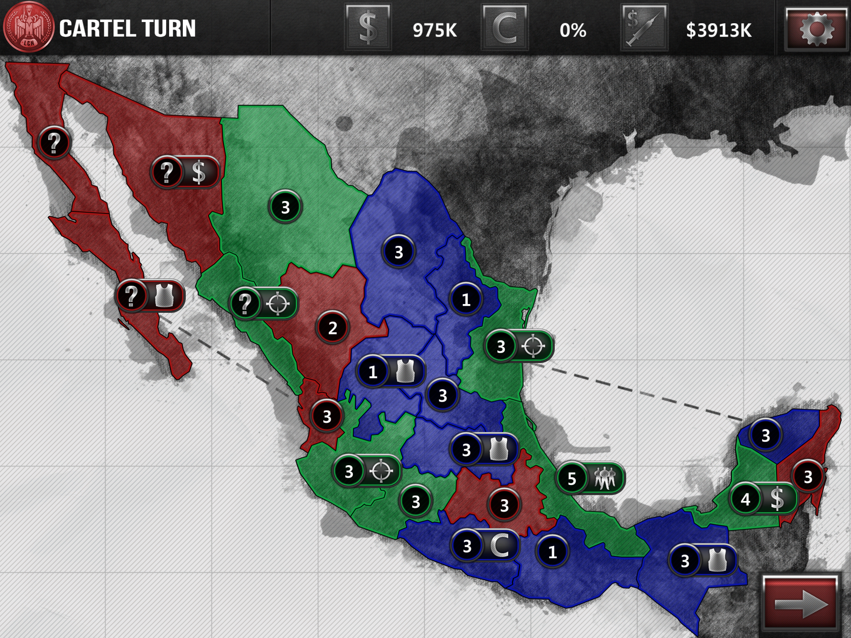

Slide 11
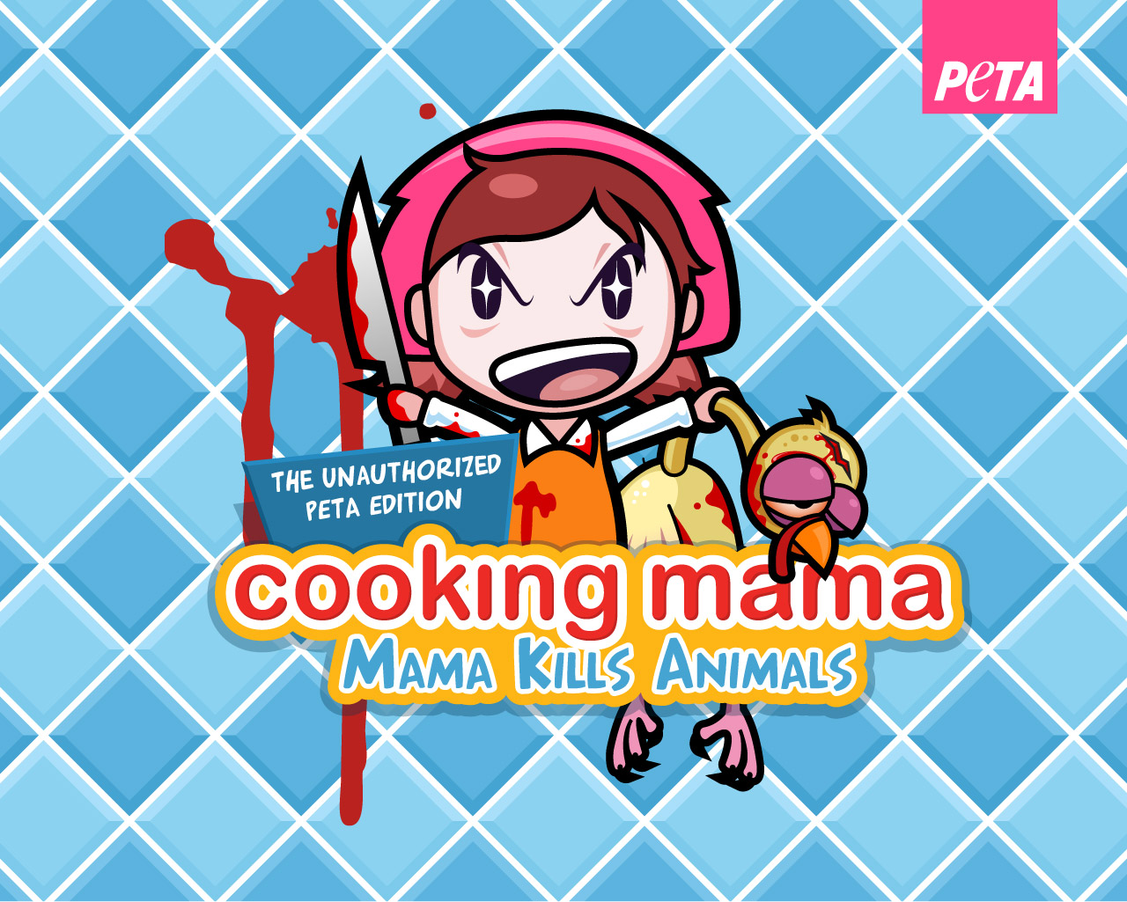


Slide 12
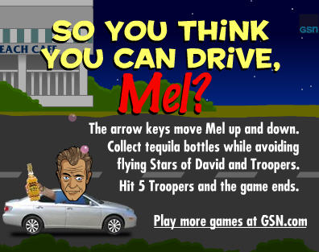
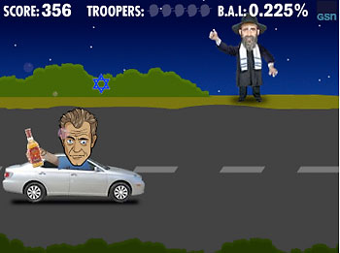

Slide 13
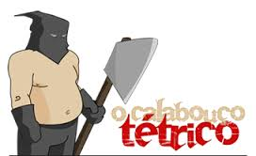
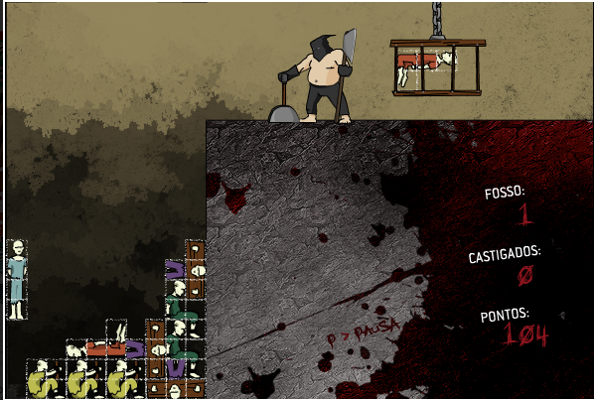

Slide 14
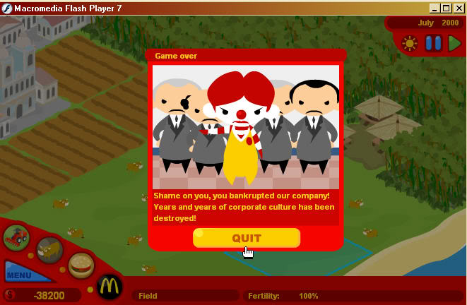
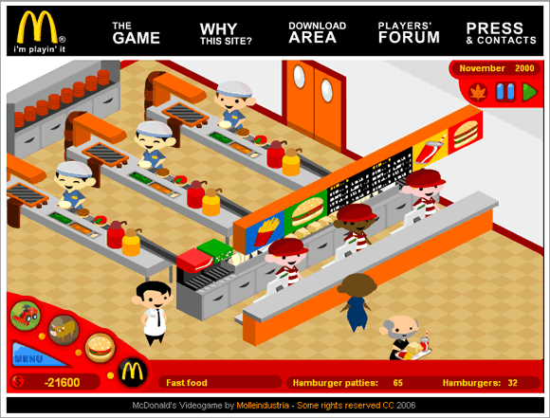

Slide 15
Characteristics of Newsgames
“any intersection of journalism and gaming” (13)
“borrow from simple arcade, home console, and casual games” (14)
low system requirements and broad distribution (15)
capitalize on public interest (tabloid newsgames) (16)
timely (including cyclical events) (18-19)
varying levels of bias vs. ambiguity

Slide 16
Types of Newsgames
current event newsgames
editorial games
tabloid games
reportage games
infographic newsgames
documentary newsgames
puzzle newsgames
literacy newsgames
community newsgames

Slide 17
A Newsgame Pitch
related news story
game elements related to the story
type of newsgame
video game genre
game mechanics / borrowed elements
bias vs. ambiguity
a sample image

Slide 18
Phillip Penix-Tadsen
“Trajectories in Latin American Game Design”
(from Cultural Code, 2016)
Types and characteristics of Latin American games
newsgames
political parodies
edugames
advergaming
work-for-hire
Latin American game design abroad
independent games
casual games

Slide 19
Phillip Penix-Tadsen
“Trajectories in Latin American Game Design”
(from Cultural Code, 2016)
Types and characteristics of Latin American games
newsgames

Slide 20
Nación Motorizada (Motorized Nation)
(Ciro Durán, Venezuela, 2012)

Slide 22
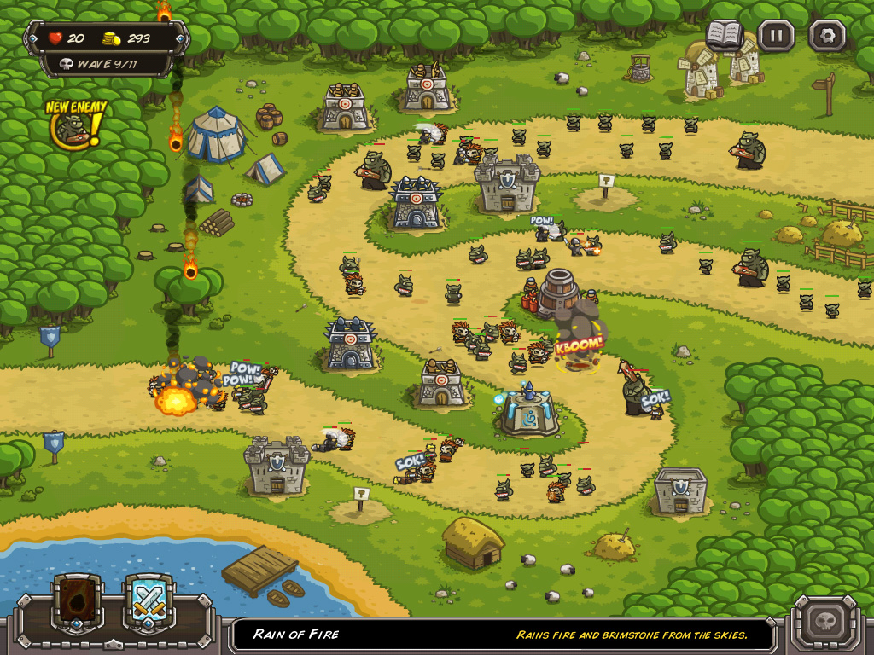
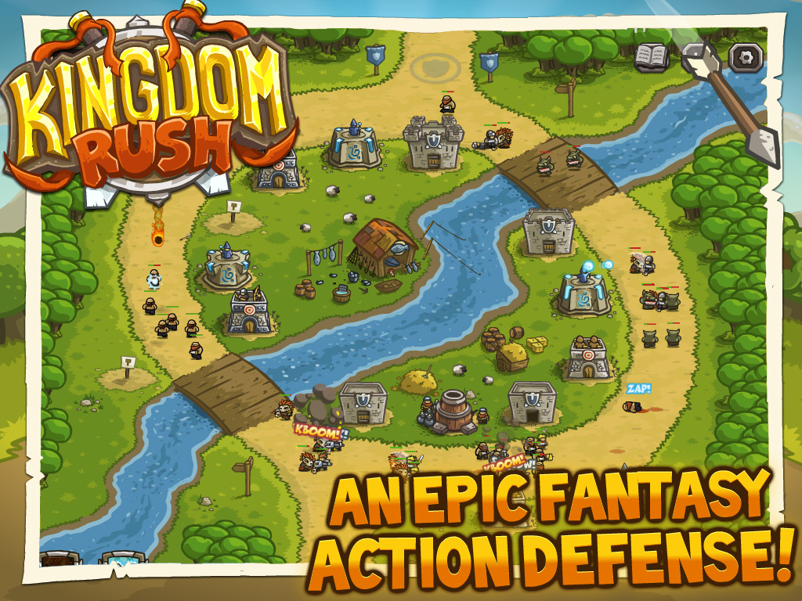
Week 12: Casual Games, Mobile Applications and Social Media Games
Kingdom Rush
(Ironside Games, Uruguay, 2011)

Slide 23
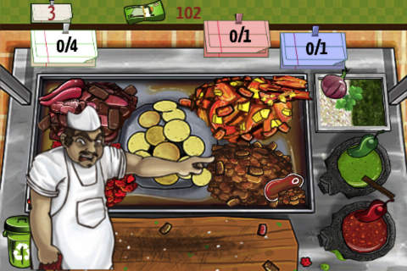
Taco Master
(Chillingo, Mexico, 2011)

Slide 24
Kingdom Rush
(Ironside Games, Uruguay, 2011)

Slide 25

Flappy Bird
Dong Nguyen 2013

Slide 26
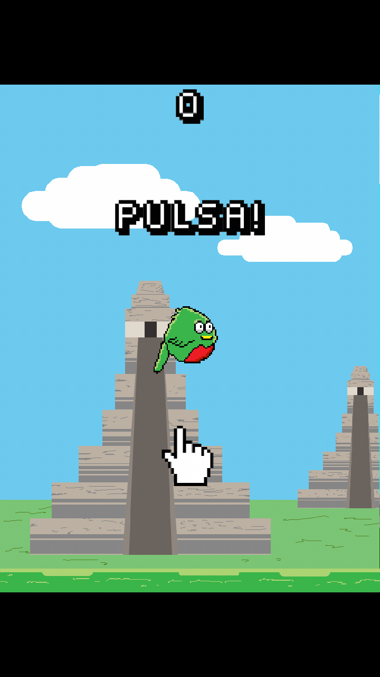
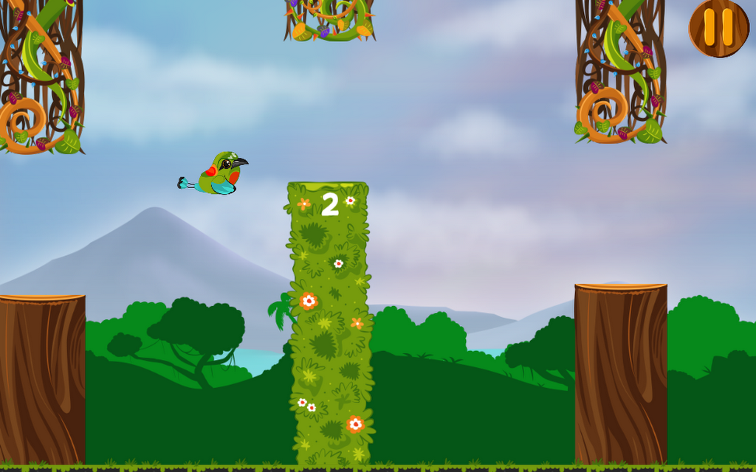
Flappy Quetzal
Carlos Villagrán, Guatemala
2014
NicaBird
Ninfusds Studio, Nicaragua
2014

Slide 27
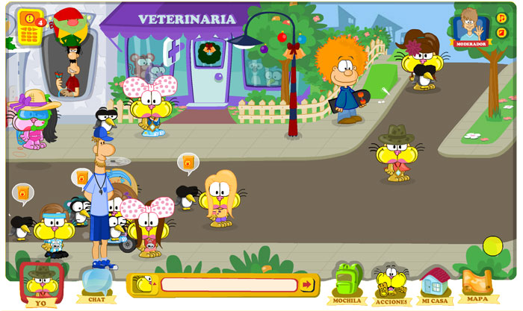
Mundo Gaturro
(Gaturro’s World)
(Clawi, Argentina, 2010)

Slide 28
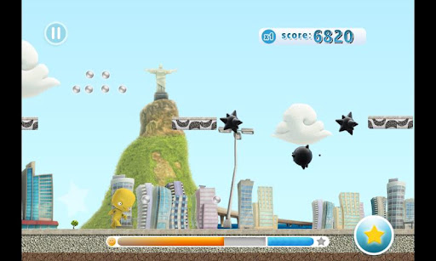
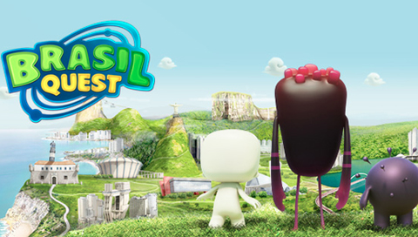
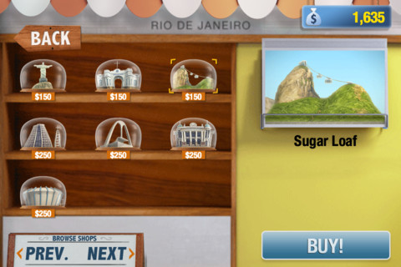
Brasil Quest
(Monumenta Comunicação e Estratégias Sociais, Brazil, 2013)

Slide 29
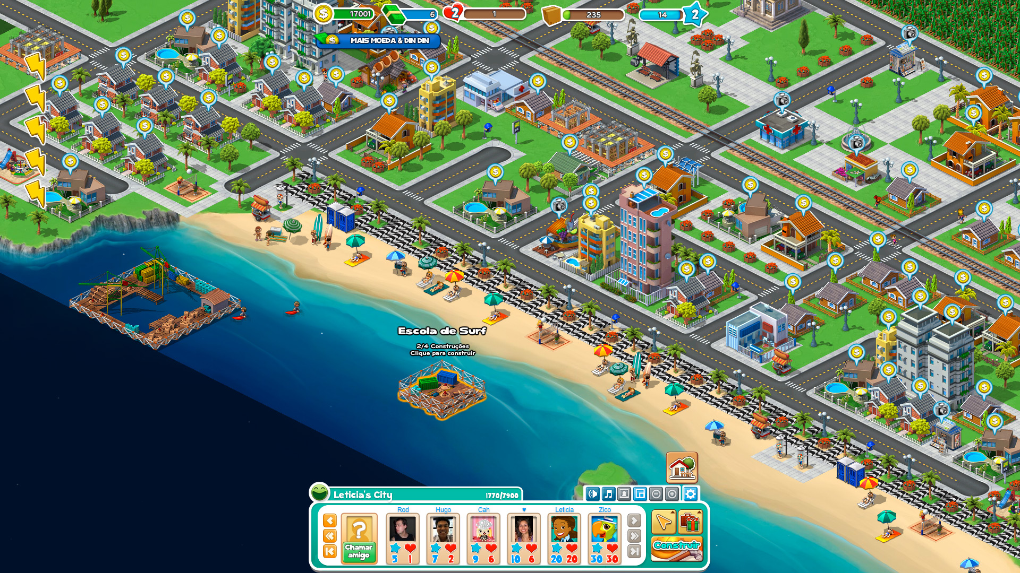
Cidade Maravilhosa Rio
(Marvelous City Rio)
(Mentez, Brazil, 2011)

Slide 30
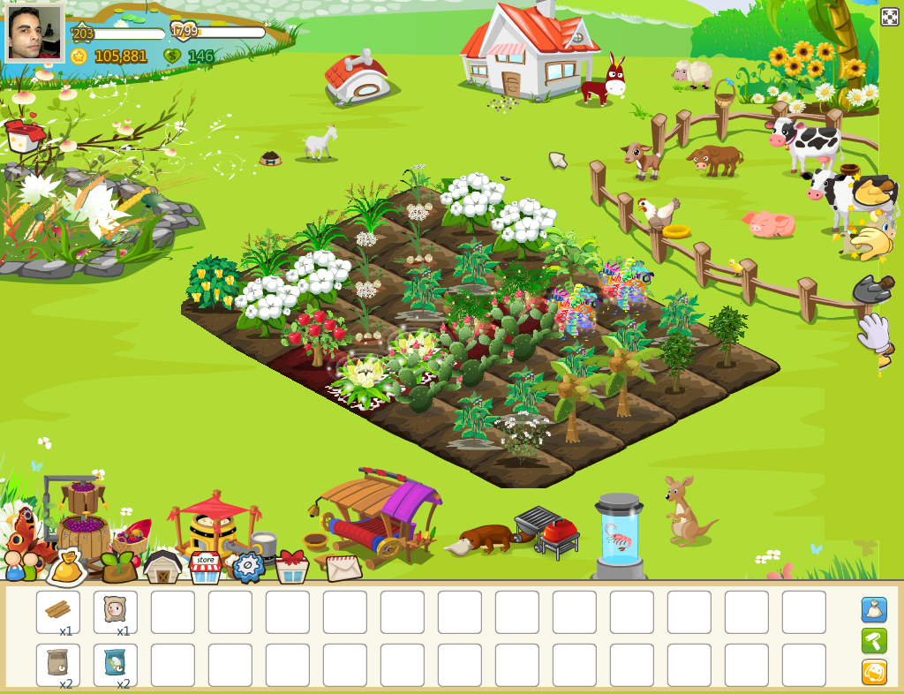
Colheita Feliz
(Happy Harvest)
(Mentez, Brazil, 2009)

Slide 31

According to Juul, how does the stereotypical casual player differ from the stereotypical hardcore player of video games? Are these stereotypes accurate?
Explain the importance of one of “The Elements of Casual Game Design” analyzed by Juul: Fiction, Usability, Interruptibility, Difficulty, or Juiciness. What is a specific example of the successful use of this characteristic in a casual game?
According to Juul, how have casual games revolutionized the landscape of the video game industry, and/or the demographics of video game players? Be specific.

Slide 32
Casual gamer
sporadic, low-level time commitment
likes easy games
positive emotional valence
easier to pick up and master
simple, straightforward game mechanics & controls
sustainability
shallow game knowledge
Hardcore gamer
serious time commitment
likes difficult games
negative emotional valence
more difficult to pick up and master
complex game mechanics & controls
sustainability
deep game knowledge

Slide 33
Flappy Bird
Dong Nguyen 2013

Slide 34
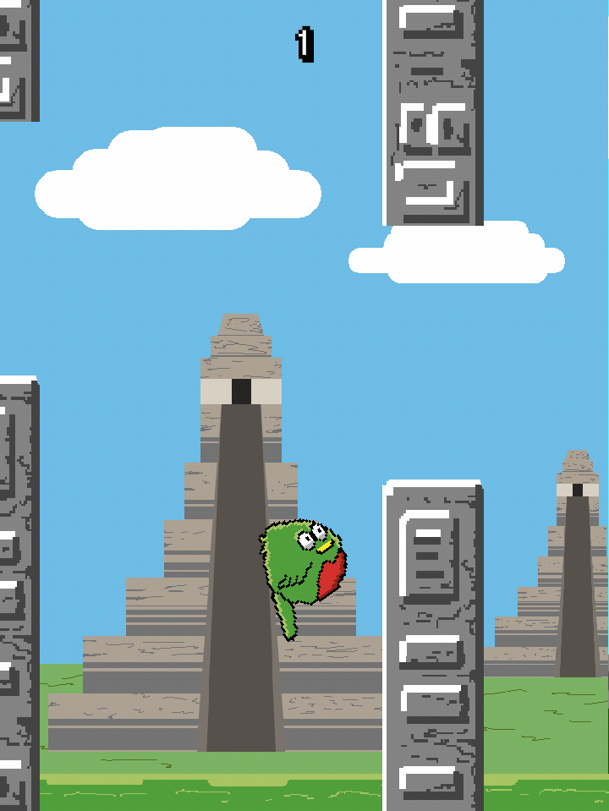
Flappy Quetzal
Carlos Villagrán 2014

Slide 35
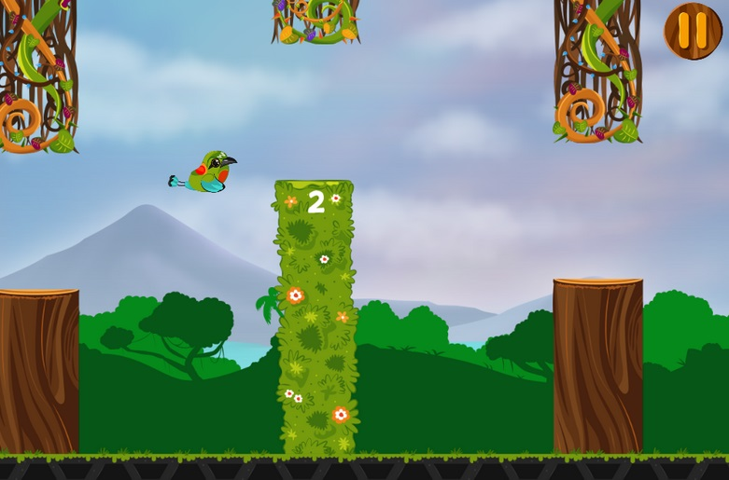
NicaBird
Ninfusds Estudio 2014

Slide 36

Eduardo Marisca “The Entrepreneurial Republic”
The role of the (global or local) game industry (186-187, 204)
The role of government
nurturing game development (185, 190-194)
Peru Service Summit / PromPerú (187-190)
FINCyT and FIDECOM (195-197)
Startup Perú (197-198)
“Latin Flavour” (188, 192)
“Innovation Ecosystems” in Colombia and Chile (201-204)
“Export Quality” (204-207)

Slide 38
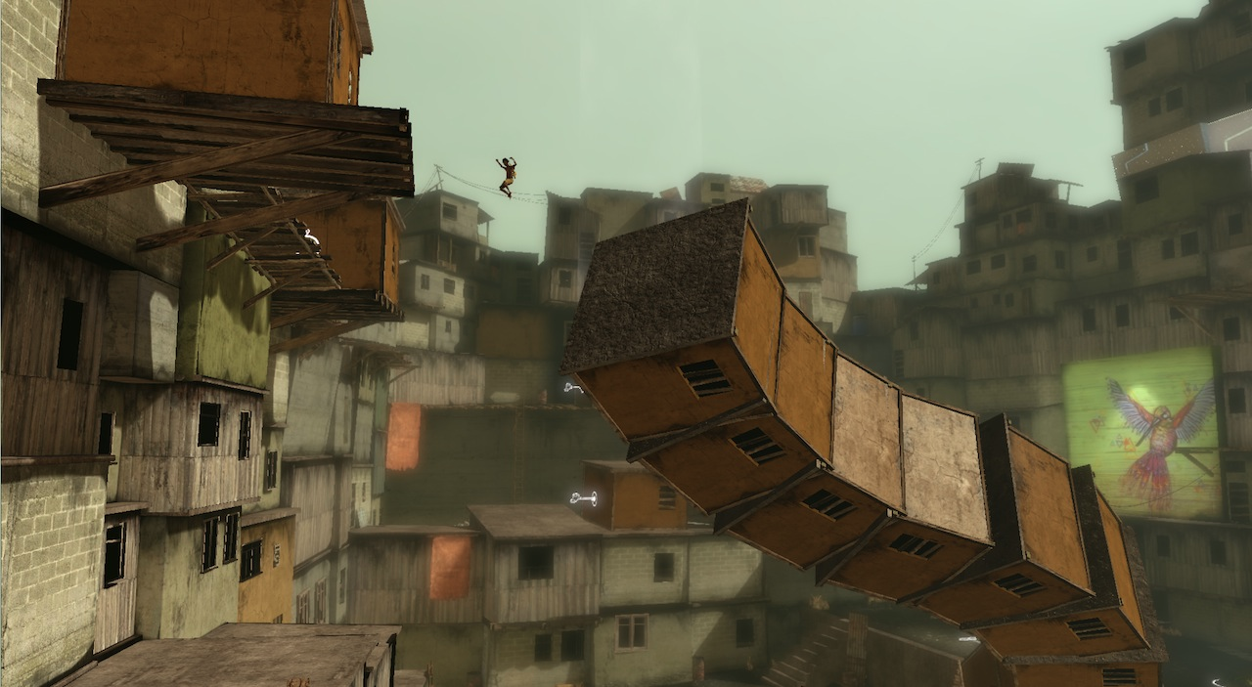
Weeks 13-14: Educational and Therapeutic Games

Slide 39
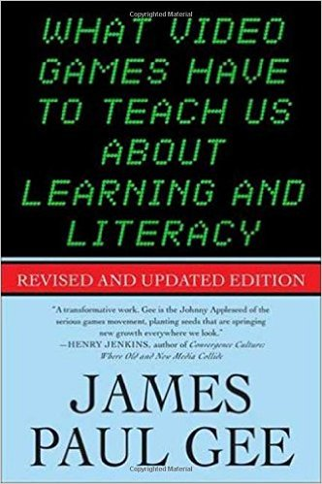
James Paul Gee “Semiotic Domains: Is Playing Video Games a ‘Waste of Time’?”
What is a “semiotic domain,” and what are some real-world examples of semiotic domains? (17-20)
What is a “design grammar,” and what are some real-world examples of design grammars? (28-29)
What is the difference between “internal” and “external” design grammars? (30-31)
What does Gee mean when he talks about “situated meaning”? (32-33)
Is playing video games a waste of time? What is the content learned by critically playing games? (22-25, 37-42)

Slide 40

Why does McGonigal say that “reality is broken” from a gamer’s perspective?
What genuine human needs (4) do video games fulfill? What evidence supports this view?
McGonigal asks, “What if we decided to use everything we know about game design to fix what’s wrong with reality?” (7) What are two examples of this process, also referred to as “gamification”?
McGonigal reassuringly states, “If you are a gamer, it’s time to get over any regret you might feel about spending so much time playing games. You have not been wasting your time.” (12) Why does McGonigal think video games are a good use of your time?
McGonigal envisions a future of “games that treat depression, obesity, anxiety, and attention deficit disorder,” as well as “games that tackle global-scale problems like climate change and poverty.” (14) What obstacles currently stand in the way of this future?
Jane McGonigal
“Introduction: Reality is Broken”

Slide 41
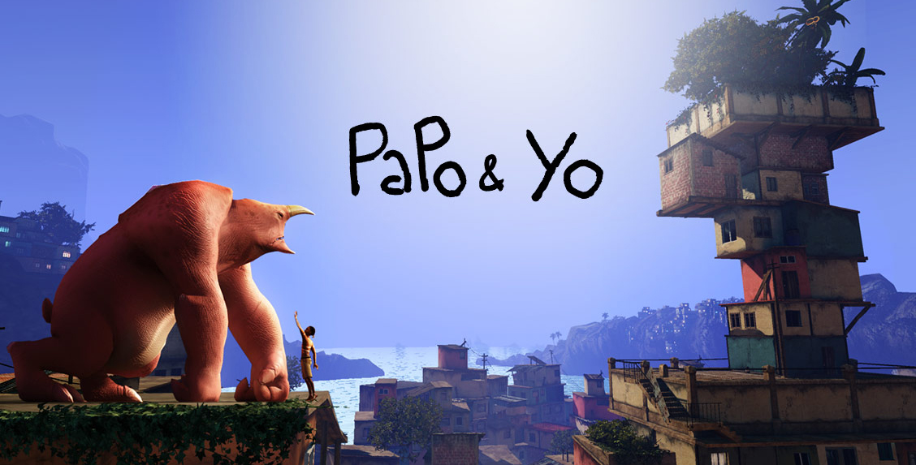
In what ways does this game relate to class readings about educational and/or therapeutic video games (such as those by Gee or McGonigal)?
What is the role of Latin American or Brazilian culture in this game?
Is this game, which was developed in Canada, a “Latin American game”? Why or why not?
How important is the backstory? Is this game of interest without the allegory?
How do you interpret the ending of the game?

